Slide 1
PLANNING COMMISSION
Board of Supervisors Chambers
400 County Center, Redwood City
ITEM 3
Owner: ………………………….
Applicant: ………………………
File Number: .…………………..
Location: ………………………..
APN: …………………….……….
Fuli Li
David Jaehning
PLN 2018-00458
Sunshine Valley Road, Moss Beach
037-156-130
Project Description:
Consideration of a Coastal Development Permit, Variance, and the adoption of a Mitigated Negative Declaration, to construct a single-family residence with internal second unit located on a 5,000 sq. ft. legal parcel. Relief from setbacks, height, daylight plane, and parking are requested through the Variance. Minor grading and removal of ten trees are proposed.
PLANNING AND BUILDING DEPARTMENT
Notes:
1

Slide 2
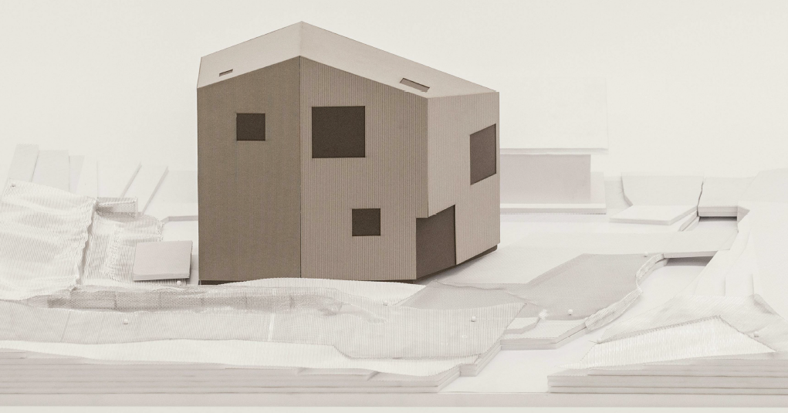
PROJECT DESCRIPTION
Proposal to construct a new 2,190 sq. ft., 3-story, single-family home to include a first floor 730 sq. ft. second unit on a 5,000 sq. ft. vacant parcel in the R-1/S-17/DR/CD zoning district.
PLANNING AND BUILDING DEPARTMENT
Notes:
2

Slide 3
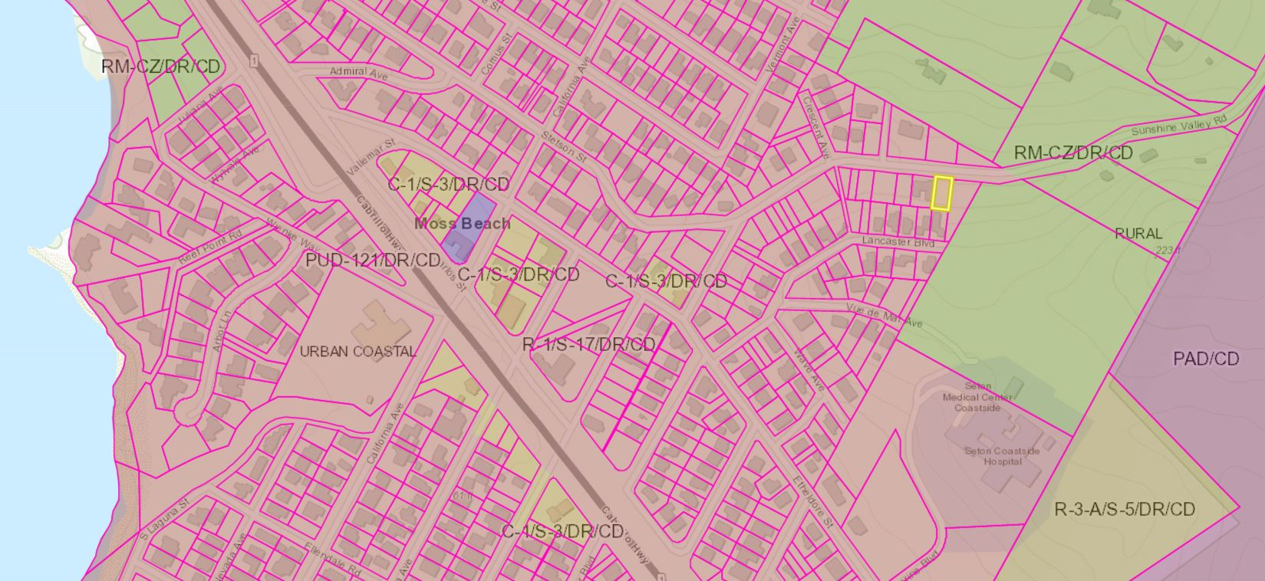
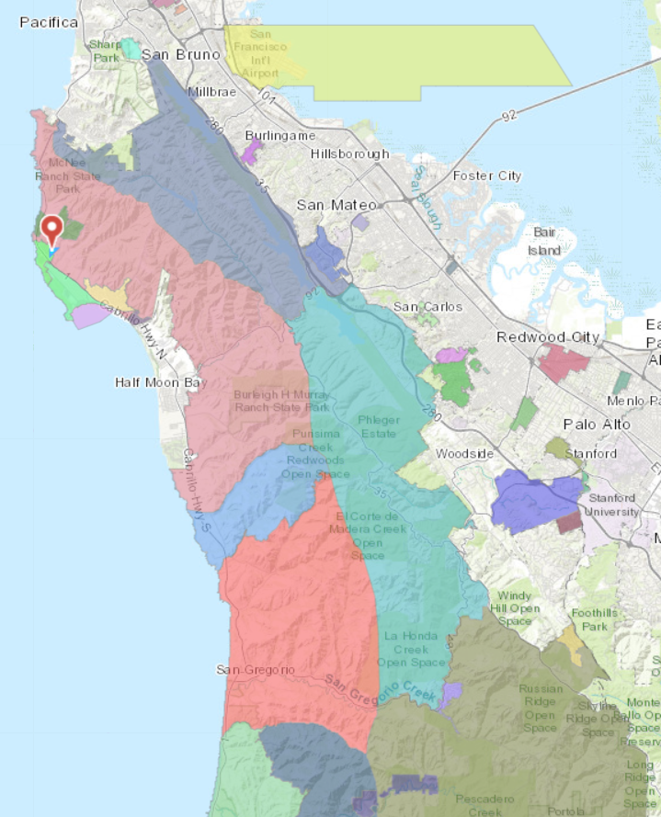
Insert photos or plans

Slide 4
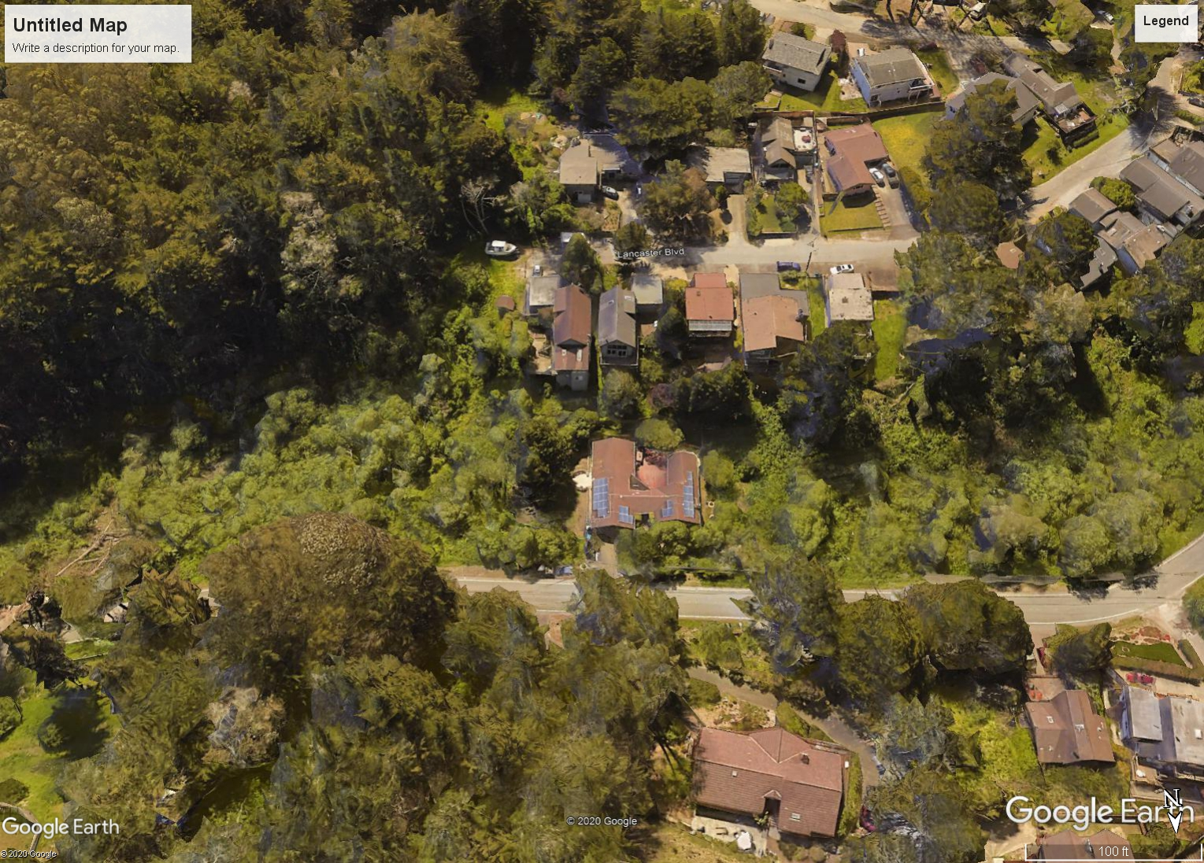
Insert photos or plans
Project Parcel

Slide 5
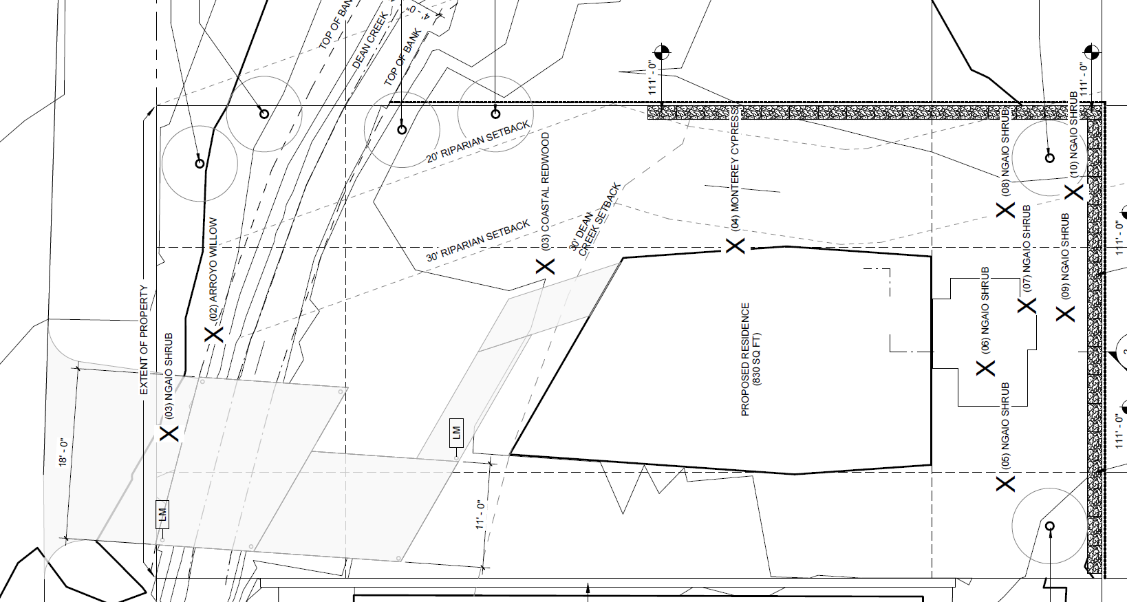
Legend
30-ft. Riparian Buffer Zone
Dean Creek
30-ft. Creek Setback
Proposed Residence
Bridge/Driveway
Sunshine Valley Road

Slide 6
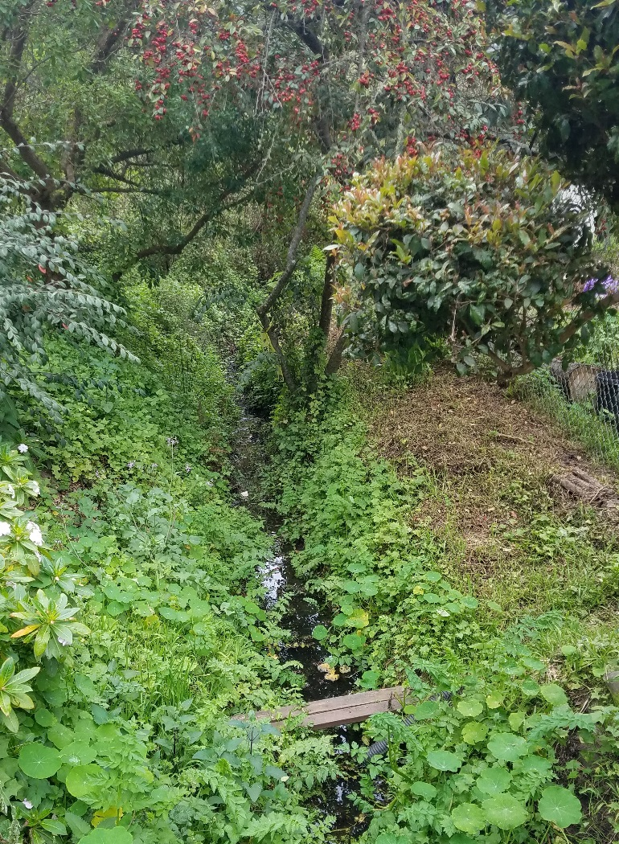
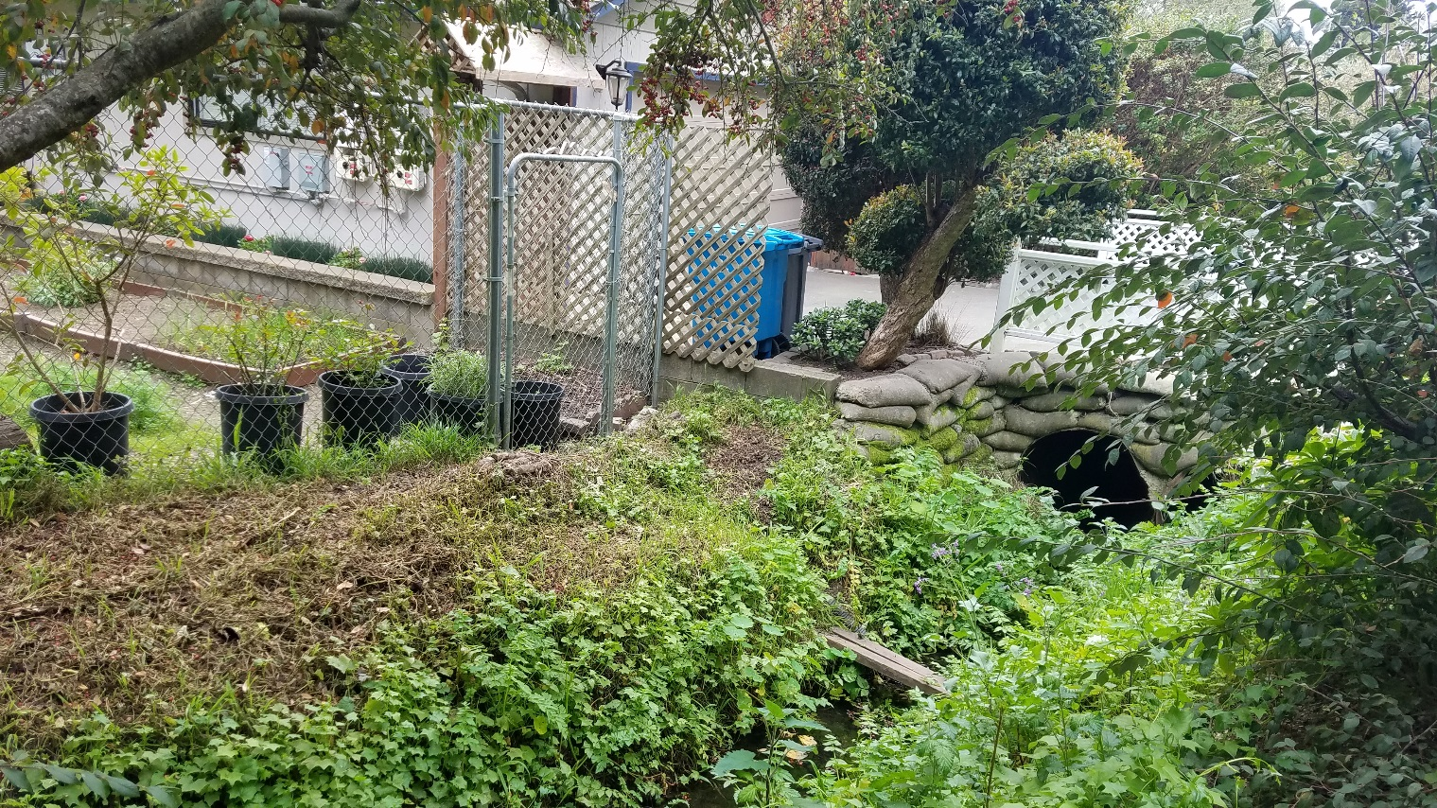
Legend
30-ft. Riparian Buffer Zone
Dean Creek
30-ft. Creek Setback
Proposed Residence
Bridge/Driveway
Creek
Neighboring Property
Creek
Creek

Slide 7
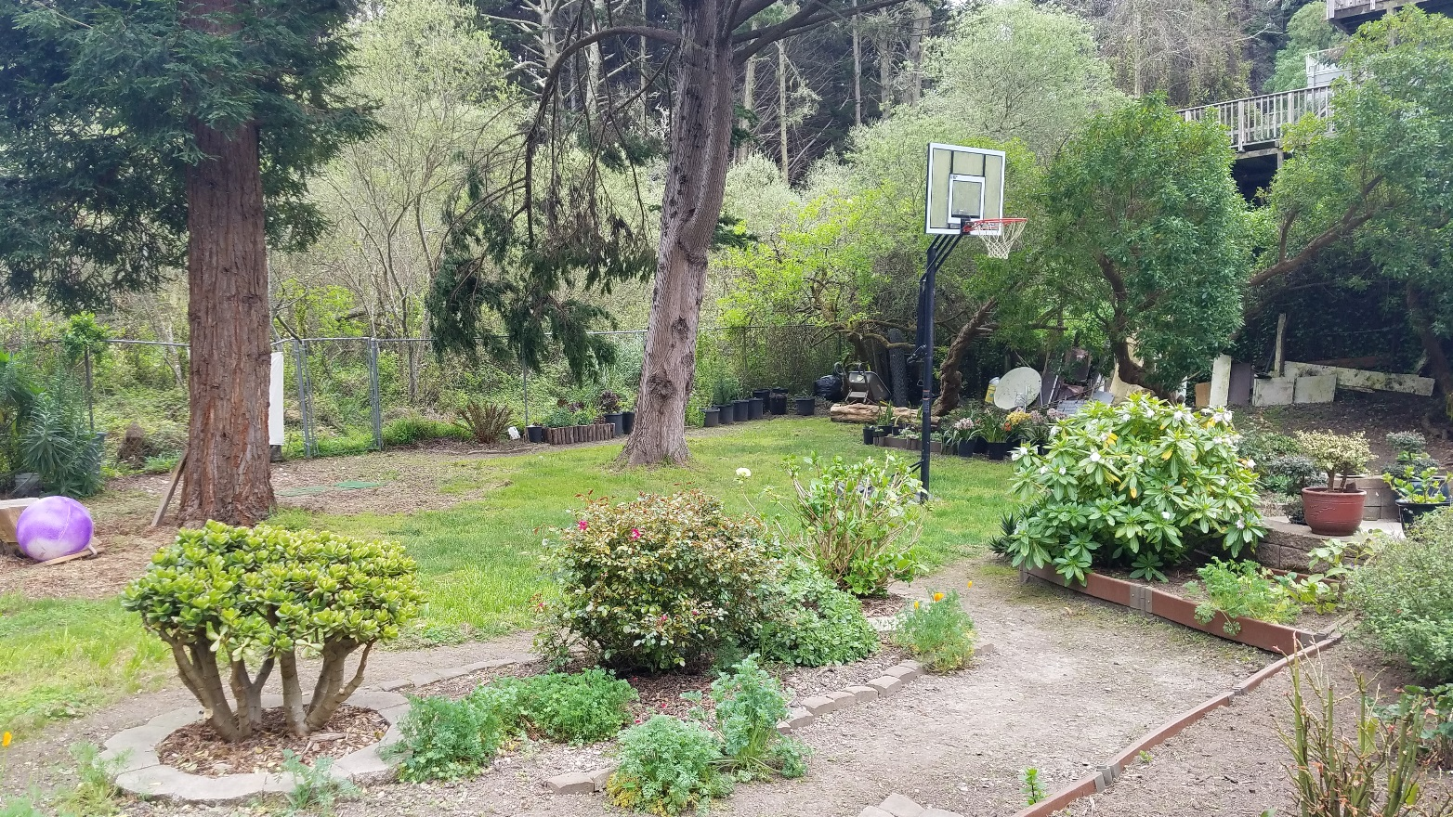
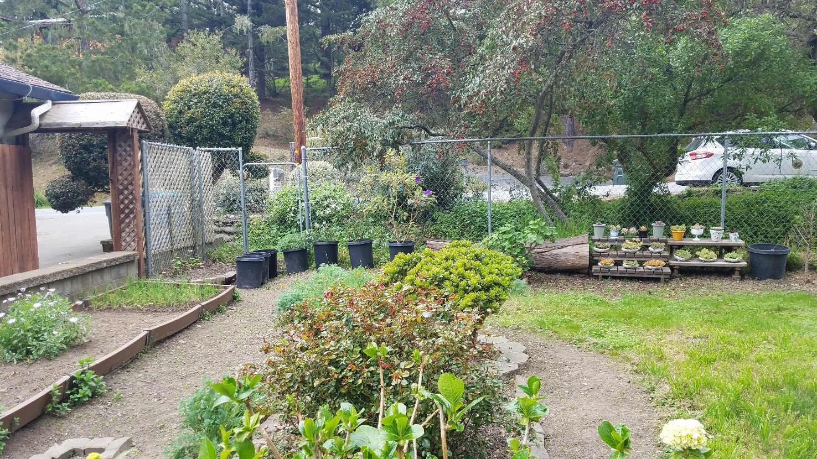
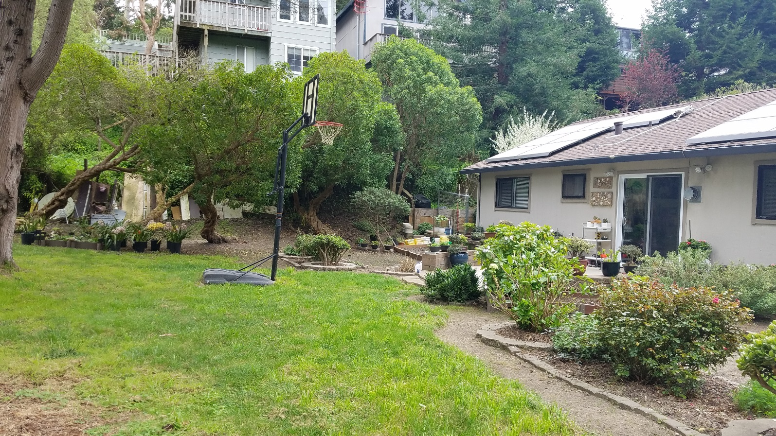
Legend
30-ft. Riparian Buffer Zone
Dean Creek
30-ft. Creek Setback
Proposed Residence
Bridge/Driveway
Left Side
Front/Sunshine Valley Road
Right Side
Rear
Right Side

Slide 8
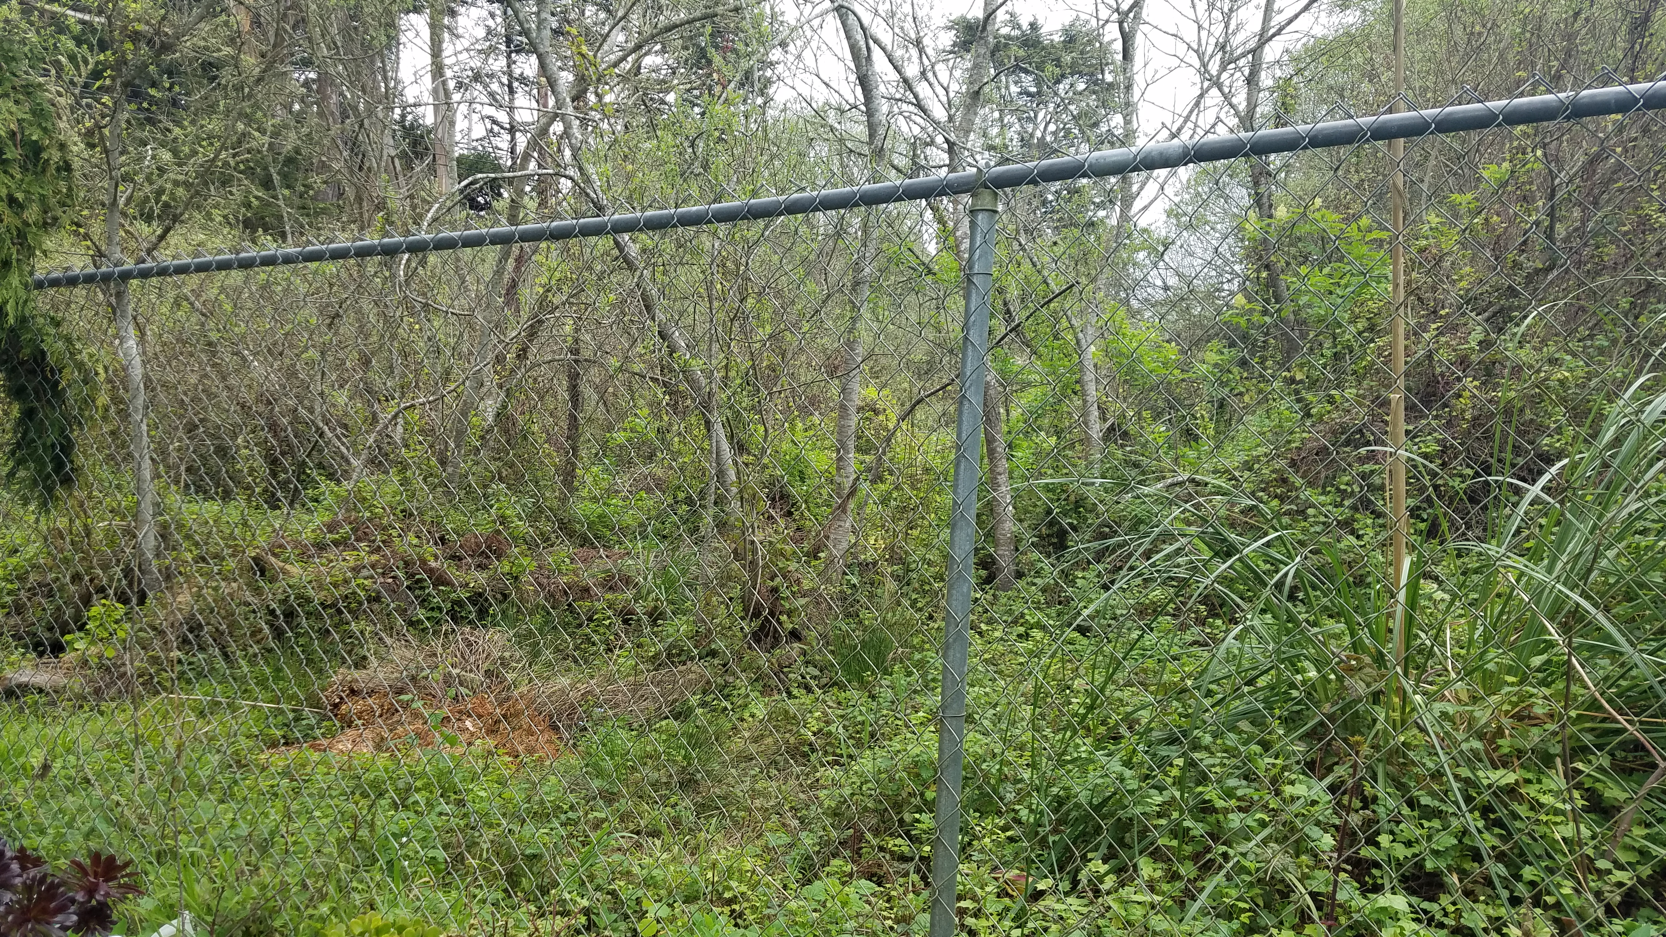
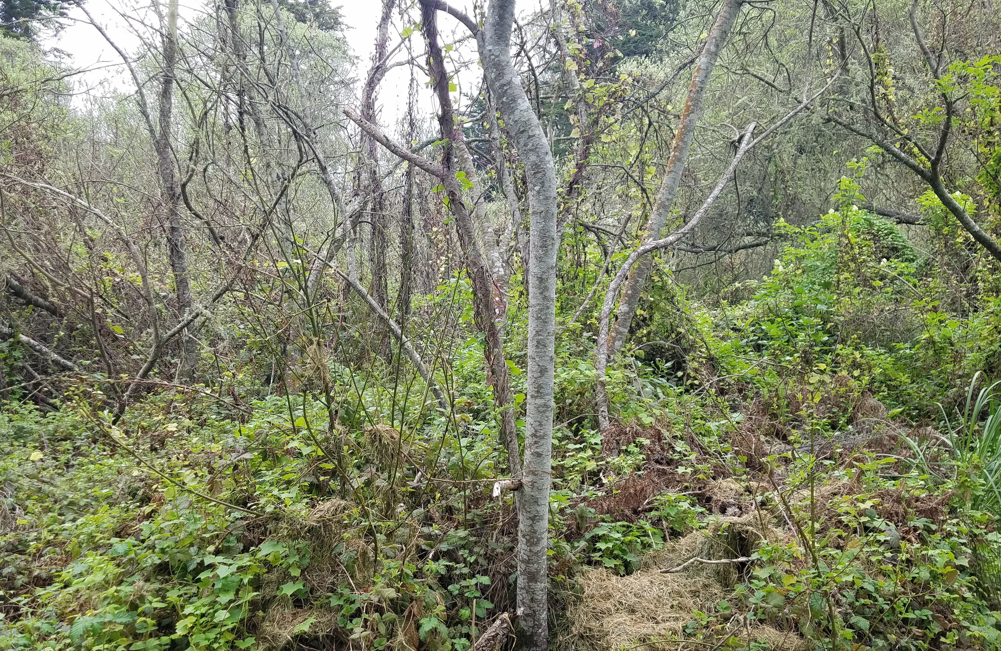
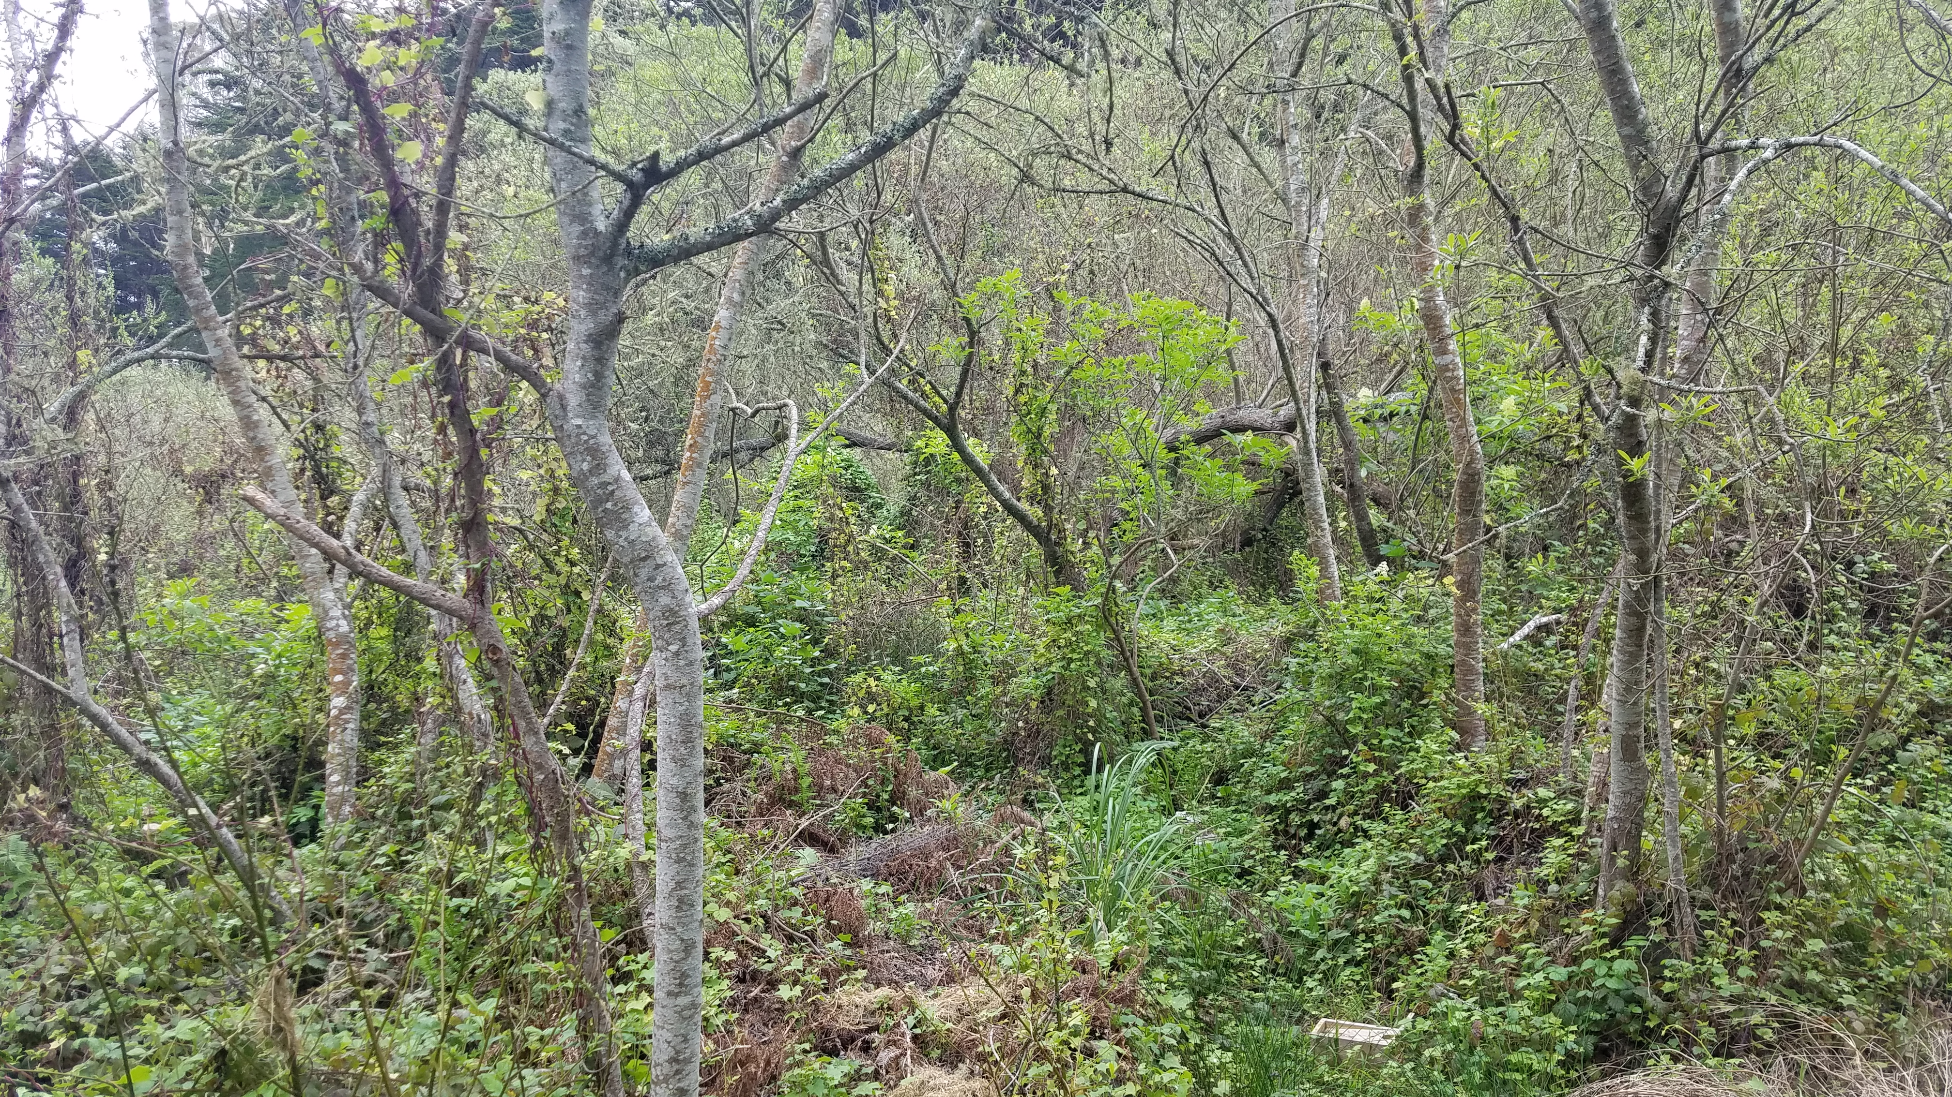
Legend
30-ft. Riparian Buffer Zone
Dean Creek
30-ft. Creek Setback
Proposed Residence
Bridge/Driveway
Riparian Vegetation to the East

Slide 9
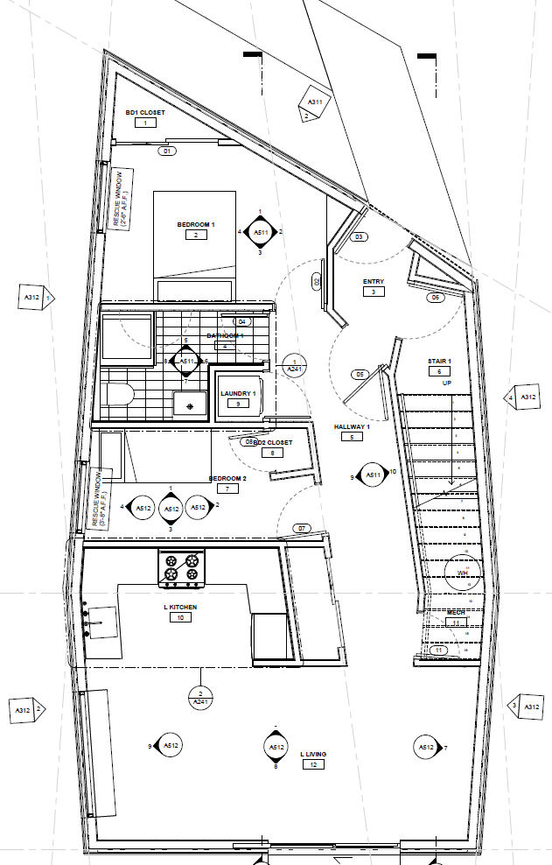
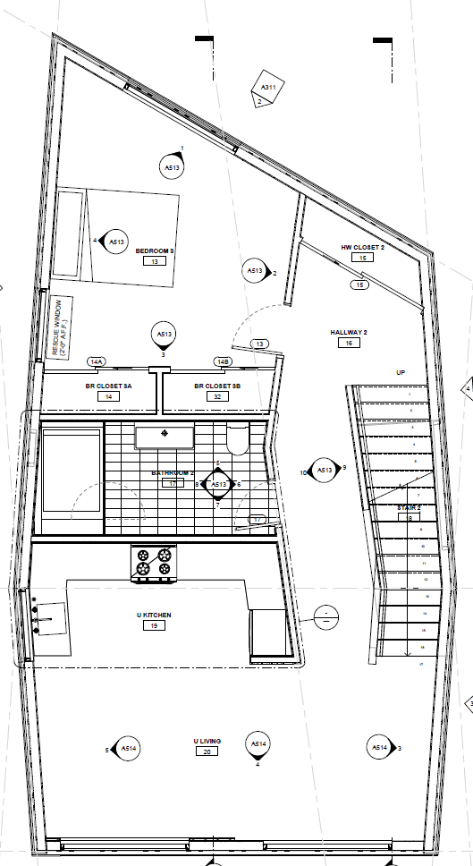
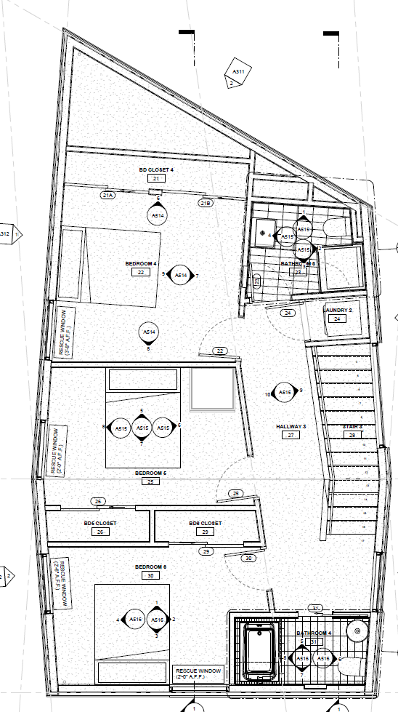
First Floor/Second Unit
Second Floor
Third Floor
Notes:
9

Slide 10
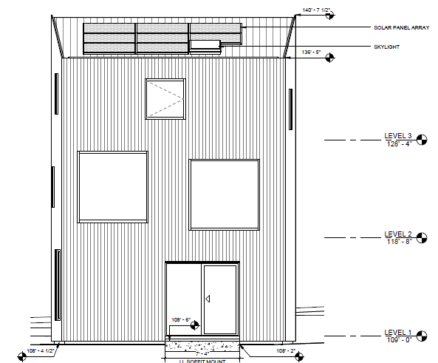
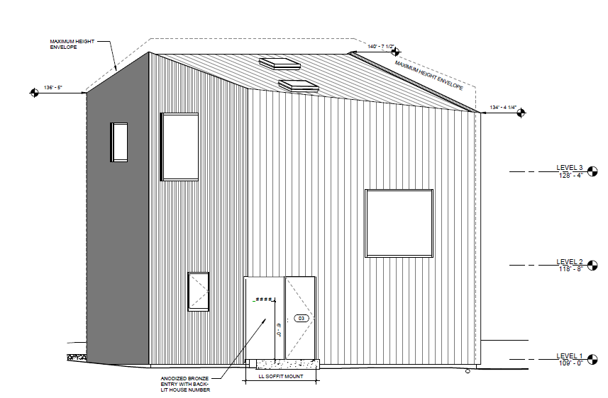
Rear Elevation
Front Elevation
Notes:
10

Slide 11
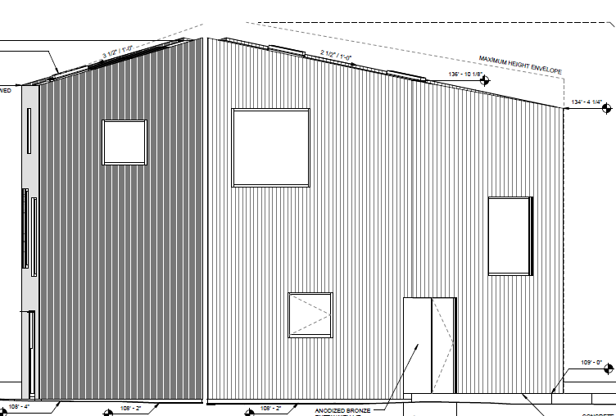
Enter text
Right Side Elevation
Left Side Elevation
Notes:
11

Slide 12
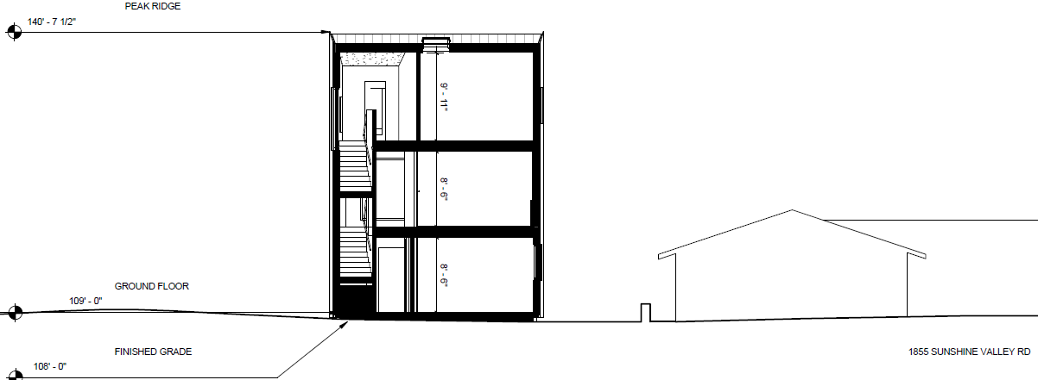
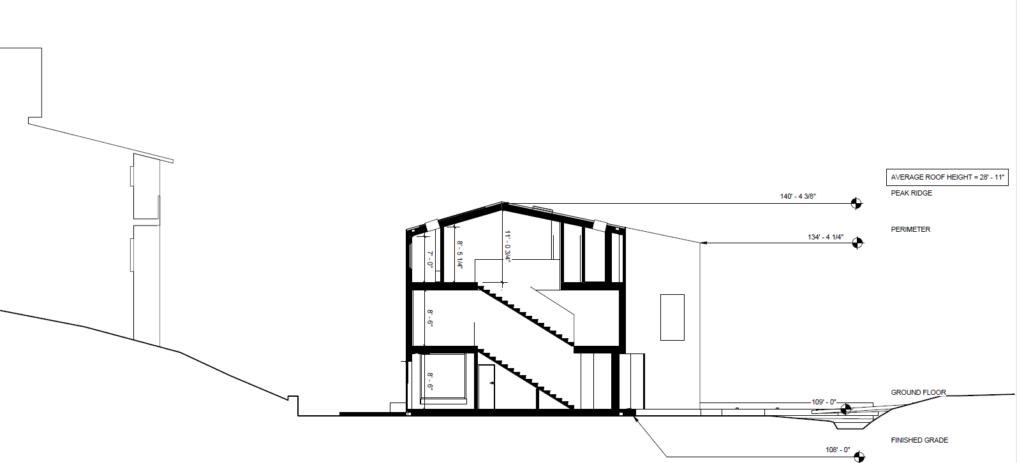
Section as seen from the front
Section as seen from the side
Notes:
12

Slide 13
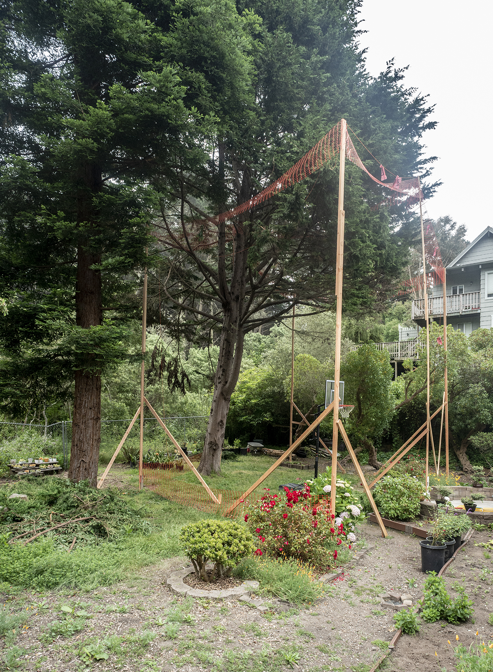
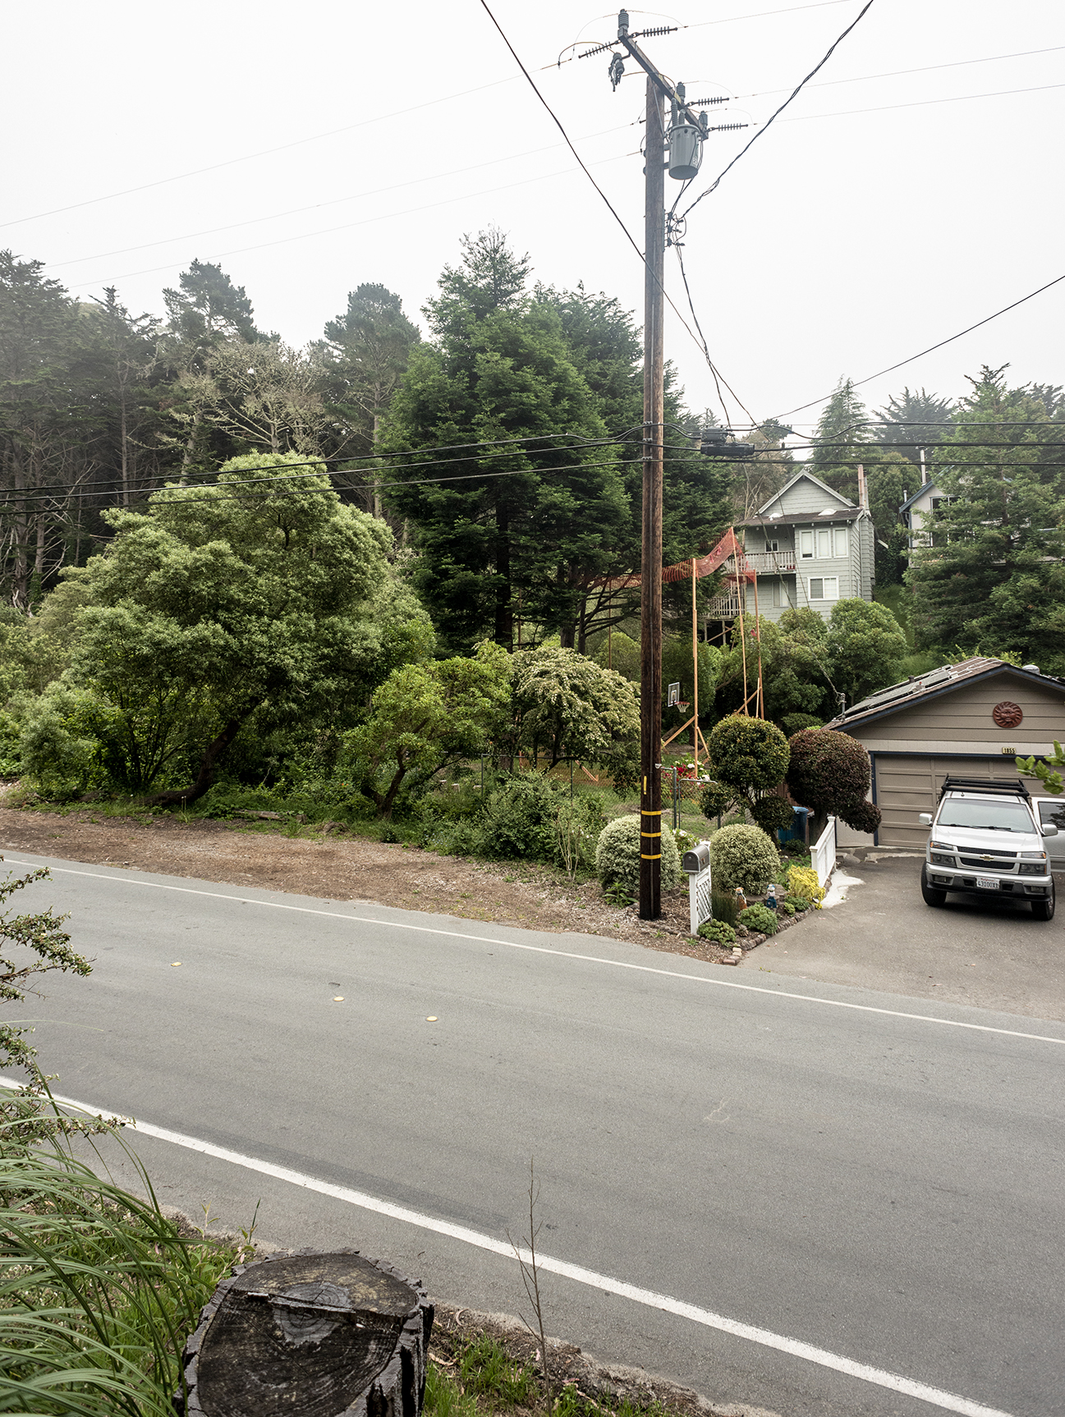
Story Poles

Slide 14
DEVELOPMENT CRITERIA
 | S-17 Development Standards | Proposed
Minimum Site Area | 5,000 sq. ft. | 5,000 sq. ft.
Maximum Floor Area | 2,650 sq. ft. (53% maximum) | 2,190 sq. ft. (44%)
Maximum Building Site Coverage | 1,750 sq. ft. (35% maximum) | 830 sq. ft. (16.6%)
Minimum Front Setback | 20 ft. | 37 ft.
Minimum Rear Setback* | 20 ft. | 18 ft.
Minimum Side Setback | Combined total of 15 ft. with a min. of 5 ft. on any side. | 26 ft.
Maximum Building Height* | 28 ft. | 31 ft. 4 in.
Minimum Parking Spaces* | 2 Covered, Side-by-Side | 2 Uncovered, Tandem
Daylight Plane* | 20 ft./45 degrees on setback lines of two opposite façades | Rear encroachment – Does not comply
* Indicates area where project does not comply, which are proposed to be included in the Variance
Notes:
14

Slide 15
VARIANCE
Legend
Exceptions Requested
Height
Rear Setback
Covered Parking
Daylight Plane
30-ft. Riparian Buffer Zone
Dean Creek
30-ft. Creek Setback
Proposed Residence
Bridge/Driveway
PLANNING AND BUILDING DEPARTMENT
Notes:
15

Slide 16
VARIANCE FINDINGS
The parcel’s location, size, shape and/or other physical conditions vary substantially from those of other parcels in the same zoning district or vicinity.
Without the variance, the landowner would be denied the rights/privileges enjoyed by other landowners in the same district/vicinity.
Variance does not grant the landowner a special privilege inconsistent with restrictions placed on other parcels in the same zoning district.
PLANNING AND BUILDING DEPARTMENT
Notes:
16

Slide 17
REGULATIONS CONFORMANCE
General Plan Policies
Local Coastal Program (LCP)
Zoning District Regulations
Coastside Design Review Standards
Variance Standards
Significant Tree Ordinance
PLANNING AND BUILDING DEPARTMENT
Notes:
17

Slide 18
ENVIRONMENTAL REVIEW
In compliance with the California Environmental Quality Act (CEQA), an Initial Study (IS) and Mitigated Negative Declaration (MND) have been prepared and circulated for this project. The public comment period commenced on
January 15, 2020 and ended on February 10, 2020. No public comments were received during this period. Mitigation measures have been included as conditions of approval in the staff report.
PLANNING AND BUILDING DEPARTMENT
Notes:
18

Slide 19
RECOMMENDATION AND FINDINGS
That the Planning Commission:
Adopt the Mitigated Negative Declaration and approve the Coastside Design Review Permit, Coastal Development Permit, and Variance based on and subject to the required findings and conditions of approval listed in Attachment A of the staff report.
PLANNING AND BUILDING DEPARTMENT
Notes:
19

Slide 20
PLANNING COMMISSION
Board of Supervisors Chambers
400 County Center, Redwood City
ITEM 3
Owner: ………………………….
Applicant: ………………………
File Number: .…………………..
Location: ………………………..
APN: …………………….……….
Fuli Li
David Jaehning
PLN 2018-00458
Sunshine Valley Road, Moss Beach
037-156-130
Project Description:
Consideration of a Coastal Development Permit, Variance, and the adoption of a Mitigated Negative Declaration, to construct a single-family residence with internal second unit located on a 5,000 sq. ft. legal parcel. Relief from setbacks, height, daylight plane, and parking are requested through the Variance. Minor grading and removal of ten trees is proposed
PLANNING AND BUILDING DEPARTMENT
Notes:
20

Slide 21
Insert photos or plans

Slide 22
Insert photos or plans

Slide 23
RECOMMENDATION AND FINDINGS
Enter text
PLANNING AND BUILDING DEPARTMENT
Notes:
23

